Slide 1
Data Manipulation & Management - Overview
Jeremy Bergmann - Omaha Data Science Academy

Slide 2
What are the course objectives?
Understand the need and purpose behind data manipulation, storage/retrieval, cleaning and management within Data Science projects.
Perform common queries, aggregations, and joins
Combine disparate data sets for analysis
Perform common data extraction, cleaning/transform and loading tasks (ETL)
Understand basic theory behind database design
Evaluate cloud storage platforms and NoSQL alternatives

Slide 3
How is this class structured?
Hour 1: Previous Class Review + Quiz, Topic 1 Lecture
Hour 2: Topic 2 Lecture, Emphasis on Application
Hour 3/4: Hands-on Exercises & Class Project, Questions

Slide 4
Class 1 Objectives
What is the need for Data Manipulation & Management?
What is SQL? What is a database?
How do you store data in a Database?
How do you obtain structured data using SQL clauses?
Practice SQL Queries in MySQL Workbench

Slide 5
What is the need for data manipulation?
Creating new datasets & Combine disparate data sets
Perform common queries, aggregations, and joins
Adding, removing, or modifying data
Extracting and Storing Data
Creation/Extraction
Transformation data
Cleaning data
Retrieval
Notes:
Creation: creating tables and databases, the things
Storage: where data are stored
Cleaning: adding, removing, or modifying data
Retrieval: selecting only the data you want

Slide 6
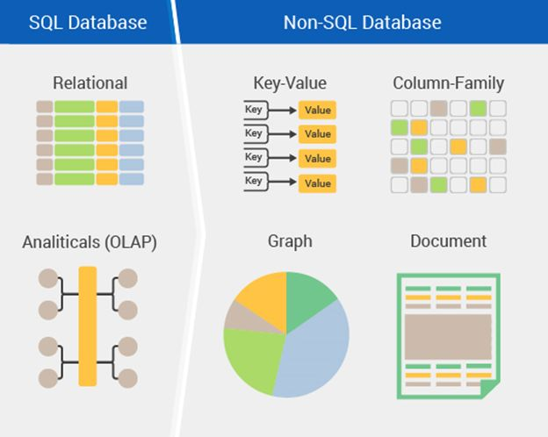
How can you manage large amounts of data?
Storage - Relational or Non-Relational DBs
Relational Database Lingo:
Table - the only data structure in SQL, where data is directly stored
Database - large container filled with tables
Field/Record - column/row
Schema - how a table or database is organized or designed
Notes:
Why Not?
SQL came first by about 40 years, so more businesses use it. Python is harder to learn. SQL is designed to only handle data, so it is fast. Faster than native Python lists or dictionaries. Pandas dataframes are appropriate depending on the context. It’s easier to show and share your work if you document your cleaning process in Jupyter Lab.

Slide 7
What is SQL?
Structured Query Language - Structured Query Language (SQL) is a standard computer language for relational database management and data manipulation
Dialects include MySQL, SQLite, MS SQL Server, Oracle, PostgreSQL, IBM DB2
Query: statement that asks for information from the database
Runs locally, on a server, or in the cloud
Simple and fast - Only one data structure, Optimized

Slide 8
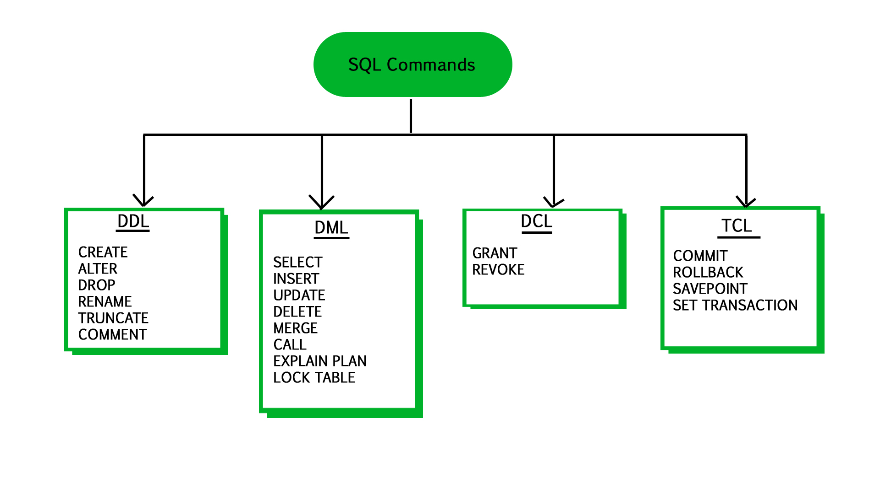
SQL Components
User Access
modifying data structures
Version Control
manipulating data
Notes:
Data Definition Language (DDL) Statements for defining and modifying data structures Ex: DROP, ALTER, RENAME, TRUNCATE
Data Manipulation Language (DML) Statements for manipulating data in tables Ex: SELECT, INSERT, UPDATE, DELETE
Data Control Language (DCL) Statements for managing users’ rights Ex: GRANT, REVOKE
Transaction Control Language (TCL) Statements for saving changes; a limited kind of version control Ex: COMMIT, ROLLBACK

Slide 9
What is a database?
A database is a collection of information that is organized so that it can be easily accessed, managed and updated.
Advantages
Security
Data integrity
Customization
Recovery
Persistence
Data Sharing
Disadvantages
Learning curve
Abstract
Maintenance & Dev costs
Notes:
Security: databases have additional security measures
Data integrity: data changes require intent
Customization: you can organize it best on your needs
Recovery: you don’t lose the data if there’s a catastrophic error
Learning curve: you have to learn how to manipulate it
Abstract: a less visual representation and demands more from the user

Slide 10
What is a table?
Tables: Any display of information in tabular form, with rows and/or columns named
Columns (fields): Set of named values that define the data within in a table.
Rows (records): A single, implicitly structured data item in a table.
CREATE TABLE students (
fname varchar(255),
lname varchar(255),
age int
);
INSERT INTO students (fname, lname, age)
VALUES ('Nathan', 'Booth', 31),
('Fatima', 'Asad', 22),
('Zoe', 'Stoklos', 42);

Slide 11
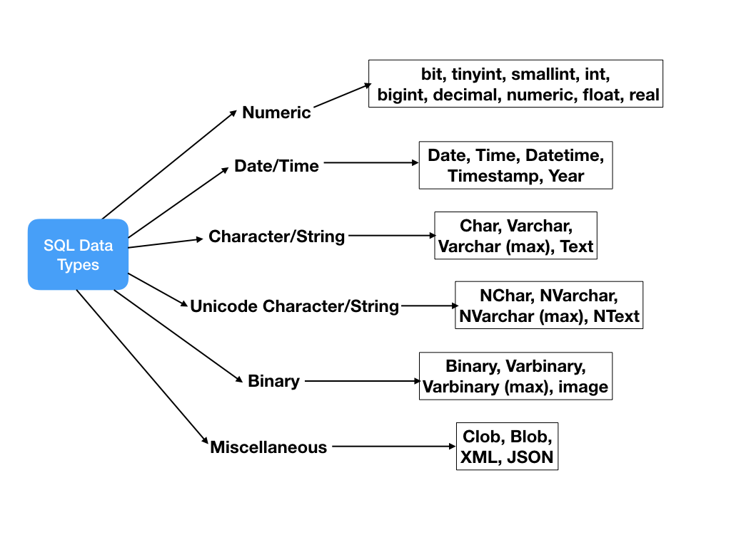
What data types can you use?
Tutorial: https://www.tutorialspoint.com/mysql/mysql-data-types.htm

Slide 12
Common Data Types
Strings | Numeric | Dates | Other
CHAR | INT | DATE | BLOB
VARCHAR | DECIMAL | DATETIME | BOOLEAN (TINYINT(1))
 | FLOAT | TIMESTAMP
 | DOUBLE
Size matters as scale increases.
Signed values: positive and negative
Unsigned values: positive only
“Big” Data Types: Hold very “large” signed/unsigned values
Precision: number of digits
Scale: number of digits right of decimal point
Fixed-point decimals: represent exact values
Floating-point decimals: represent approximate values
BLOB: binary large object, stores files as binary data

Slide 13
Writing Queries
Jeremy Bergmann - Omaha Data Science Academy

Slide 14
Writing Queries - Objectives
Practice using common SQL clauses
Practice using common aggregations
Practice using comments for debugging or explaining code
Learn SQL functions
Practice writing subqueries
Practice using SQL by examples in MySQL Workbench
Notes:
Feynman technique: Learn -> Explain -> Reflect -> Repeat
What are the most important ideas from last class? Write a summary of the information as if explaining to a 14 year old. Avoid jargon Keep the words and sentences simple Rely on memory Make the explanation visual, if possible Note where you had difficulty or have knowledge gaps. These indicate things you should review, research, or ask questions about

Slide 15
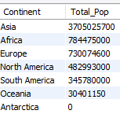
Example - Continent Query
What is the total world population by continent?
SQL Query
SELECT Continent, sum(Population) as Total_Pop
FROM world.country #“what schema/table to read”
GROUP BY continent #“often needed to summarize by group”
ORDER BY continent DESC #“Sort rows in result”
Notes:
Format for readability
FROM: what table to read
SELECT: what columns to get
AS: rename the column
GROUP BY: combine rows by column value
ORDER BY: sort in ascending or descending order
LIMIT: constrain the number of rows displayed

Slide 16
Common SQL Clauses
Purpose: A SQL Clause defines the “order of execution” of a SQL query, along with the required operations to obtain data from a relational database.
Main Clauses (1) | JOIN (2) | WHERE (3) | SELECT (4) | Aggregations (5)
FROM | (INNER) | NOT | DISTINCT | AVG
WHERE | LEFT (OUTER) | AND | AS | COUNT
GROUP BY | FULL OUTER | OR | CASE | SUM
HAVING | RIGHT | LIKE |  | MIN
SELECT | CROSS | BETWEEN |  | MAX
ORDER BY |  | IN
 |  | <, >, <=, >=, =, !=
 |  | NULL
Order of Execution
Notes:
“Main clauses” in descending order of operations
Wildcard characters: %, _, *
CASE: if-then statements
JOIN: mostly use INNER, LEFT
HAVING: WHERE for groups (http://www.mysqltutorial.org/mysql-having.aspx)
BETWEEN is inclusive

Slide 17
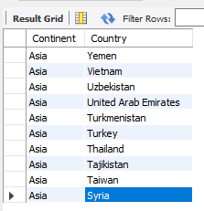
Example - World Query
Obtain a list of countries within the continent of Asia.
SQL Query
SELECT Continent, Name as Country #what columns to get
FROM world.country #what schema/table to read
Where Continent = 'Asia' #limit results”
ORDER BY continent, country DESC #Sort rows in result”
LIMIT 10 #number of rows to “bring back”
Notes:
Format for readability
FROM: what table to read
SELECT: what columns to get
AS: rename the column
GROUP BY: combine rows by column value
ORDER BY: sort in ascending or descending order
LIMIT: constrain the number of rows displayed

Slide 18
SQL Operators
Purpose: A comparison (or relational) operator is a mathematical symbol which is used to compare two values, usually in the “where” or “select” clauses of a SQL Query. The result of a comparison can be TRUE, FALSE, or UNKNOWN (an operator that has one or two NULL expressions returns UNKNOWN).
Operator Type | SELECT Clauses
Arithmetic | Add, Subtract, Multiply, Divide
Comparison | Equal to (=), Greater than (>), Less than (<), Greater Than or Equal to (>=)
Logical | AND, BETWEEN, EXISTS, IN, LIKE, NOT, OR
Notes:
“Main clauses” in descending order of operations
LIKE: wildcard searches: %<char>, %<char>%, <char>%, underscores
Wildcard characters: %, _, *
CASE: if-then statements
JOIN: mostly use INNER, LEFT
HAVING: WHERE for groups (http://www.mysqltutorial.org/mysql-having.aspx)
BETWEEN is inclusive

Slide 19
SQL Functions
Aggregate functions: Avg, Count, Sum, Min/Max
String: Concat, Length, Left, Replace, Substring, Trim, Format
Control flow functions: Case, ifnull, nullif
Date and Time functions: Curdate, DateDiff, Day/Month/Year, TimeDiff, now
Comparison functions: Coalesce, isnull
Math functions: Ceiling/Floor, Round, Truncate
Data Types: CAST
Tutorial: http://www.mysqltutorial.org/mysql-functions.aspx
Notes:
Aggregate Function: aggregate function performs a calculation on a set of values and returns a single value.

Slide 20
Example - Continent Query
What is the total world population by continent?
SQL Query
SELECT Continent, sum(Population) as Total_Pop
FROM world.country #what schema/table to read data
GROUP BY continent #summarize by group
ORDER BY continent DESC #Sort rows in result
HAVING sum(Population) > 0 #Limit final results of agg.
Notes:
Format for readability
FROM: what table to read
SELECT: what columns to get
AS: rename the column
GROUP BY: combine rows by column value
ORDER BY: sort in ascending or descending order
LIMIT: constrain the number of rows displayed

Slide 21
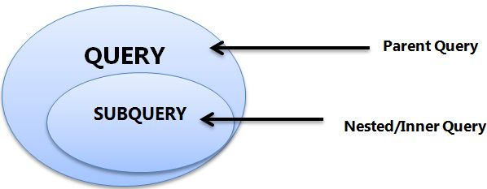
Subqueries
A.K.A. nested queries, inner queries, inner select
Must be enclosed by parentheses
Ex: SELECT <col> FROM <table>WHERE (SELECT <col> FROM <table>);
Can return single value (aka scalar), single row, single column, or table
Evaluated inside-out

Slide 22

Example - World Query
What is the total population of the continent of Asia?
SQL Query
SELECT subq.Continent, sum(subq.Population) as Total_Pop
FROM (
select Continent, Name as Country, Population
from world.country
where Continent = 'Asia'
) as subq #using subquery
group BY subq.Continent
Subqueries are often used to return a subset of an entire dataset!

Slide 23
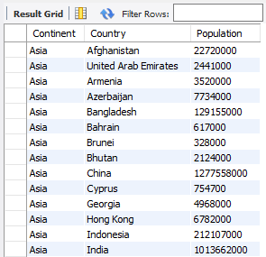
How did it work?
SQL SubQuery
Summarize the Population of all Asian
Countries by Continent

Slide 24
Where can you learn more SQL?
Interactive Tutorials
W3schools
SQLZoo
Mode Analytics
SoloLearn
SQL Tutorial
SQLBolt
Database Performance (advanced)
Static Tutorials and Books
TutorialsPoint
Head First SQL (Chpt.1 free)
SQL: A Beginner's Guide
SQL in a Nutshell
SQL for Smarties (advanced)
Video
Basics in an hour
Khan Academy
Game
Schemaverse
Sandbox
SQLfiddle
MySQL Sandbox
Courses
Codecademy (self-paced, free and paid)
Stanford’s Database Mini-Courses
SQL Course 2
Documentation and Help
MySQL Reference Manual
Databases 101
MS SQL Server
Stack Overflow
Reddit

Slide 25
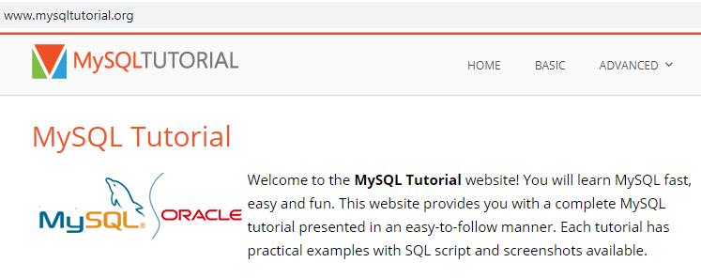
Practice Resources
References
Data types primer
Aggregation primer
Subquery primer
Practice:
SQLZOO
CodeWars
(SQLite 3.2.8, PostgresSQL 9.6)
HackerRank
(DB2, MySQL, Oracle, MS SQL Server)
Data.world
Google BigQuery

Slide 26

Exercises
World Schema (Class 2 Exercise – Queries.sql)
1. In world.city, What are the names and CountryCodes of all countries in the database (sorted alphabetically by code)?
2. Return the names of all cities contained in the world.city table that are in the united states.
3. Find the total population of all USA cities that are in the world.city table
4. Return the names of all cities contained in the world.city table that are in Nebraska (Region), using a subquery
5. In the world.country langage table, select all countries where the official language is ‘English’
6. In the world.country table, compare the average life expectancy of people, in a variety of ways.
Resource: “OSDA-DataManipulationAndManagement\Examples” Folder

Slide 27
Purpose
To create an end-product that’s similar to what would be produced in a business environment, utilizing the knowledge gained in this course.
Steps – Data Science (CRISP-DM) Process
Understand Business Problem (What should you solve for?)
Understand Data
Prepare Data
Build Model/Data Flow
Test/Evaluate Process
Deployment - Answer business questions, Generate additional questions
Resource: “GitHub\OSDA-DataManipulationAndManagement\Class Project” Folder

Slide 28
Project Milestones
Import data into MySQL database (Class 1)
Query Data for Data Understanding/Relevant Information (Class 1)
Storing/Joining data for analysis (Class 2)
Cleaning Data for Analysis (Class 3)
Analyze Data Quality & Create Data Dictionary (Class 3)
Normalize Data & Create Data Model (Class 4)
Connect MySQL to Data Visualization Tool, Answer Business Questions, Automate data workflow using ETL (Class 5)

Slide 29
Class Project - Import Console Data
Utilize MySQL’s “Table Data Export and Import Wizard”
Step 1 – Obtain CSV files from “GitHub\OSDA-DataManipulationAndManagement\Class Project\Tables” folder
Step 2 - Click right-click any table in the database, then use the “Table Data Import Wizard”
Step 3 - Select location of data from local drive
Step 4 - Select Destination - “Use Existing” or “Create New Table”
Step 4a - If new table, need to define column names and SQL data types
Step 5 - Execute Import and Enjoy!
Import Wizard - Tutorial: https://dev.mysql.com/doc/workbench/en/wb-admin-export-import-table.html

Slide 30

Class Project
Business Understanding - Queries
1. Based on the collected console data, what is the newest platform in our dataset and what year was it first available?
2. Which console had the longest lifespan (in years)?
3. Based on game data, which country has the most video game sales, over all platforms?
4. How many video games were produced for the NES platform?
5. What Genre of games had the most unit sales for the XBox 360 system?
6. Overall, what is the most popular genre of games, by unit sales?
7. Based on this information, what type of game and/or console would you recommend to management?

